Slide 1

Price Analysis on Geysers based on Ratings and Features

Slide 2
About us
NAME QUALIFICATION
: P. Mahesh
: B. Tech
NAME QUALIFICATION
: ch.Anusha
: MBA

Slide 3
Contents :
Problem Statement
Objective
Libraries
Website URL’s for Web-Scrapping
Raw Data
Data Cleaning and Data Manipulation
Cleaned Data
EDA
Challenges
Conclusion

Slide 4
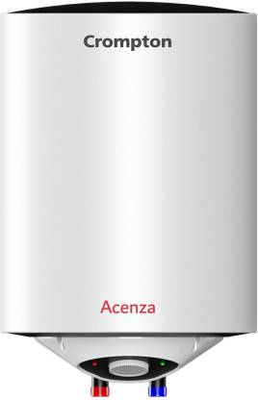
Problem Statement:
Which features affects the price of geysers effectively.
Why geysers cost different amounts by exploring factors like Model type, color and storage capacity.
How these features affect geyser Prices.
What really matters when it comes to geyser Pricing.
Objective:
From this project , we are interested to provide good insights to choose better geyser.

Slide 5






Libraries Used:
Requests
Beautiful Soup
Pandas
Numpy
Matplotlib
Seaborn
Language Used:
Python

Slide 6
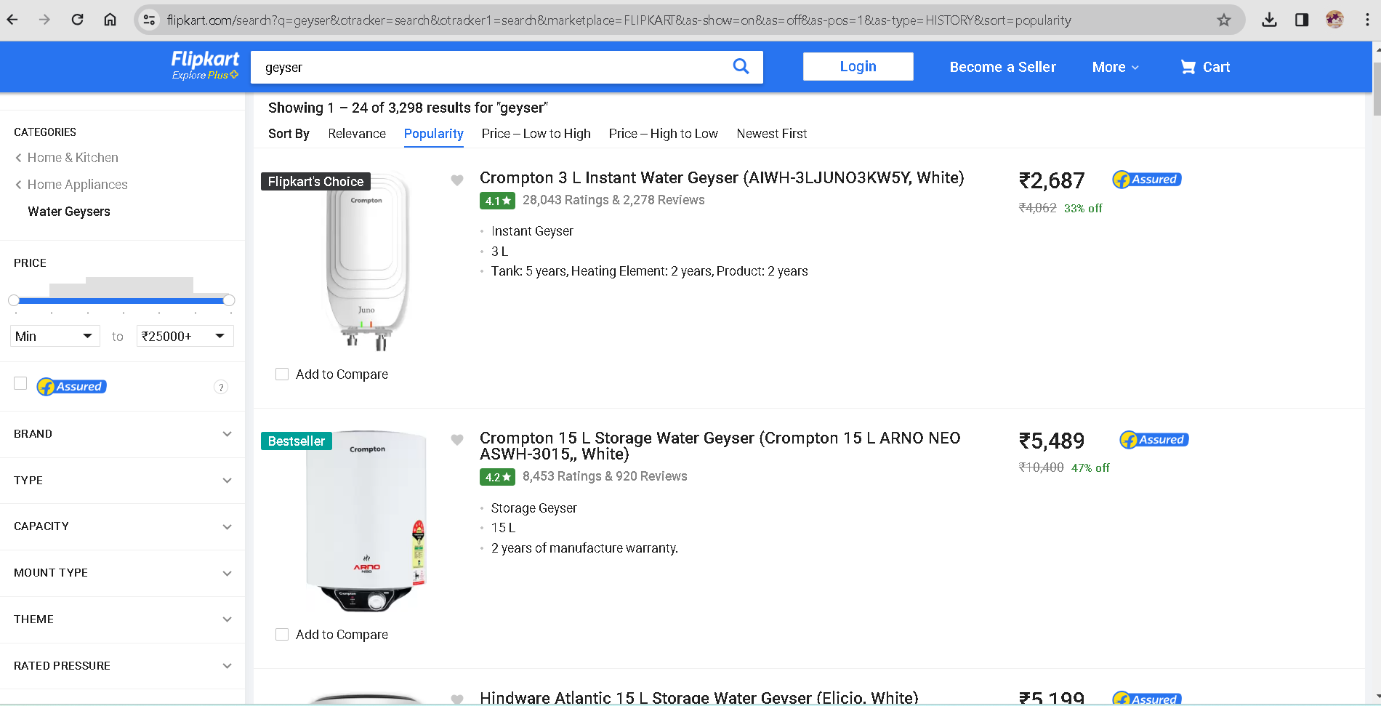
Website URL’s for Web-Scrapping :
https://www.flipkart.com/search?q=geyser&otracker=search&otracker1=search&marketplace=FLIPKART&as-show=on&as=off&as-pos=1&as-type=HISTORY&sort=popularity

Slide 7
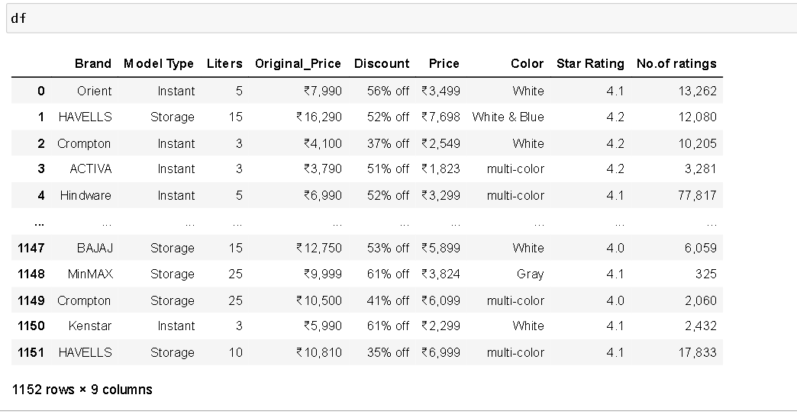
Raw data from website:
Insights : We got 1152 rows and 9 columns in the Raw data.

Slide 8
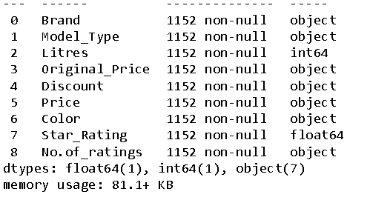
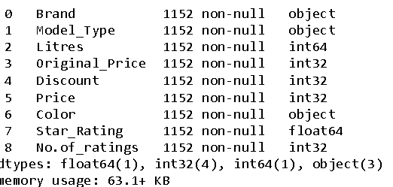
Data Cleaning Steps :
We have segregated values as required.
Updated datatypes of columns into as required.
We have gone through some special characters.

Slide 9
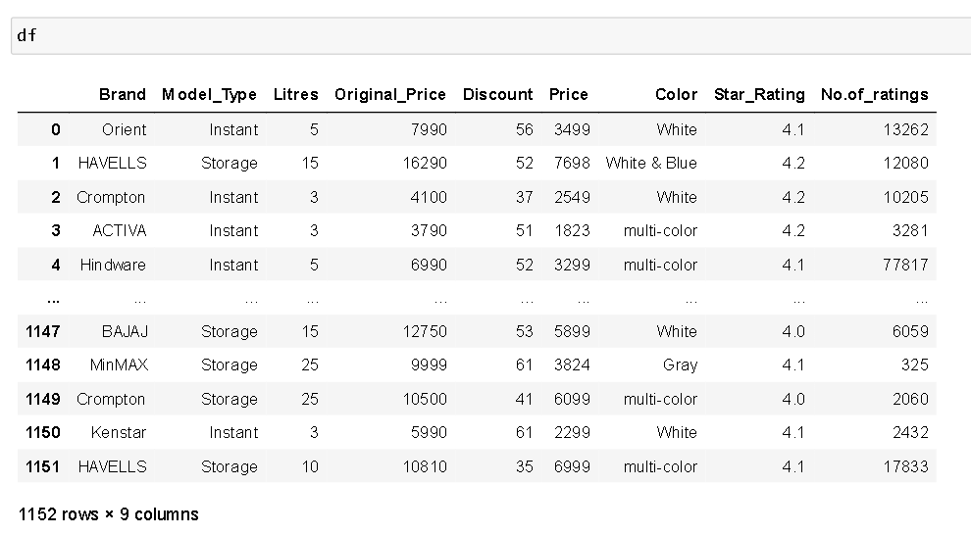
Cleaned Dataframe :

Slide 10

Data Visualization :
Representing data into pictorial format.
We have used Uni-variate , Bi- variate and Multi-Variate for analysis and Visualization of the data.

Slide 11
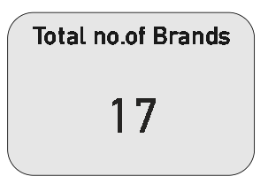
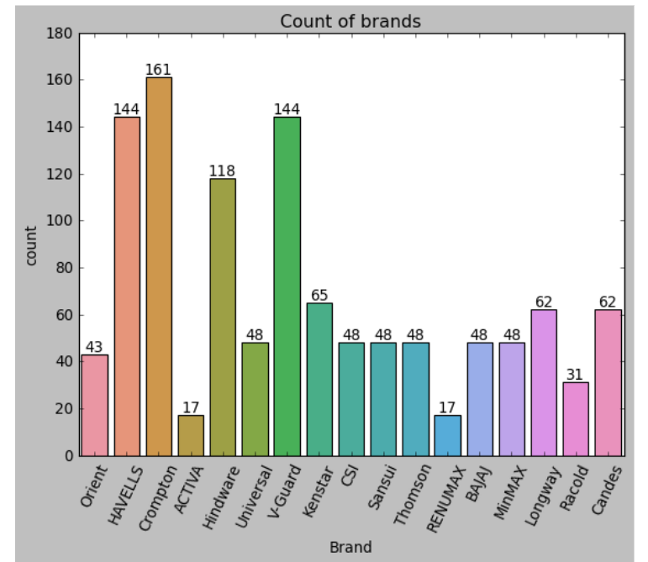

Different type’s of Geyser products by Brands
Crompton is the leading company having huge variety of features.

Slide 12
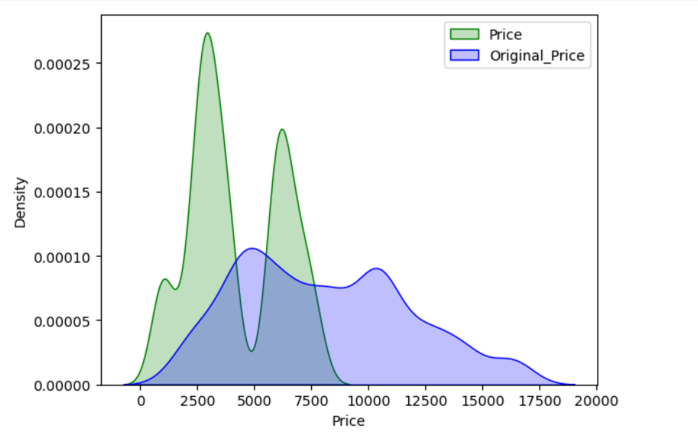
What is the price range of Geyser?
Most of the products fall within range of 2K to 4K

Slide 13
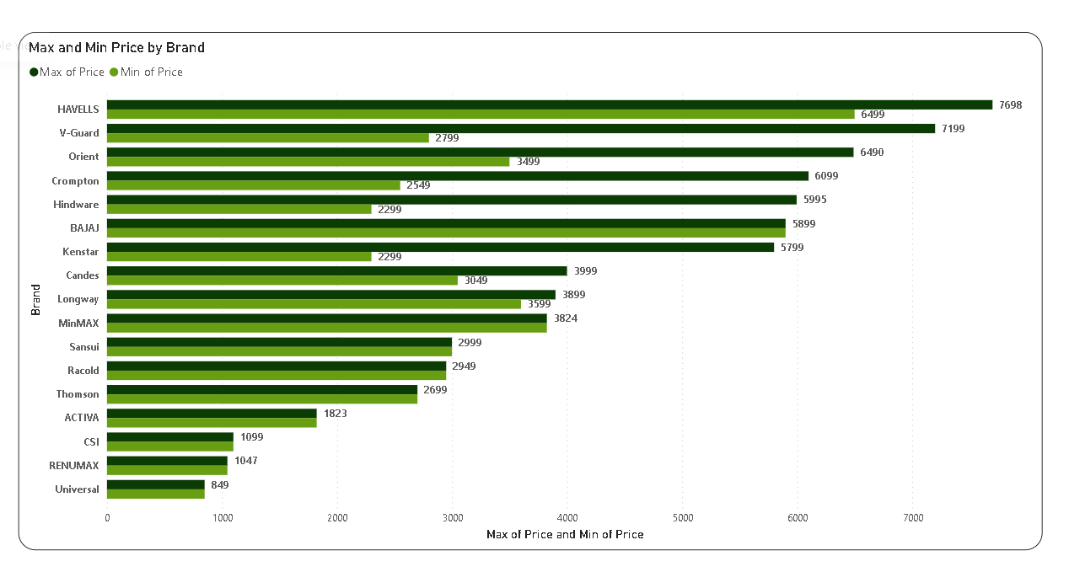
Price based on Brand

Slide 14
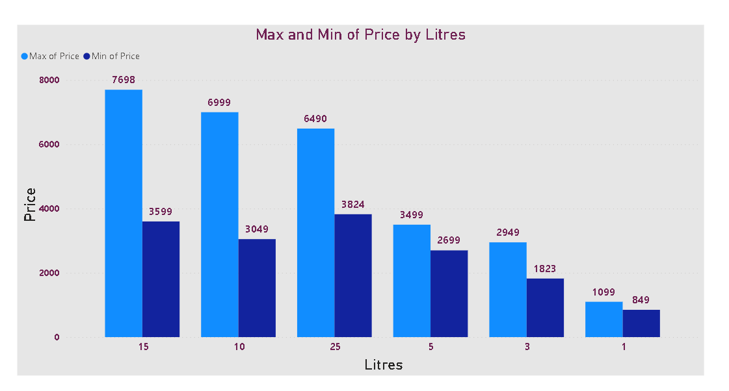
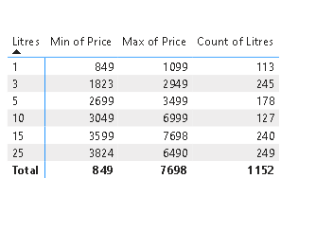
Price Analysis by Litres

Slide 15
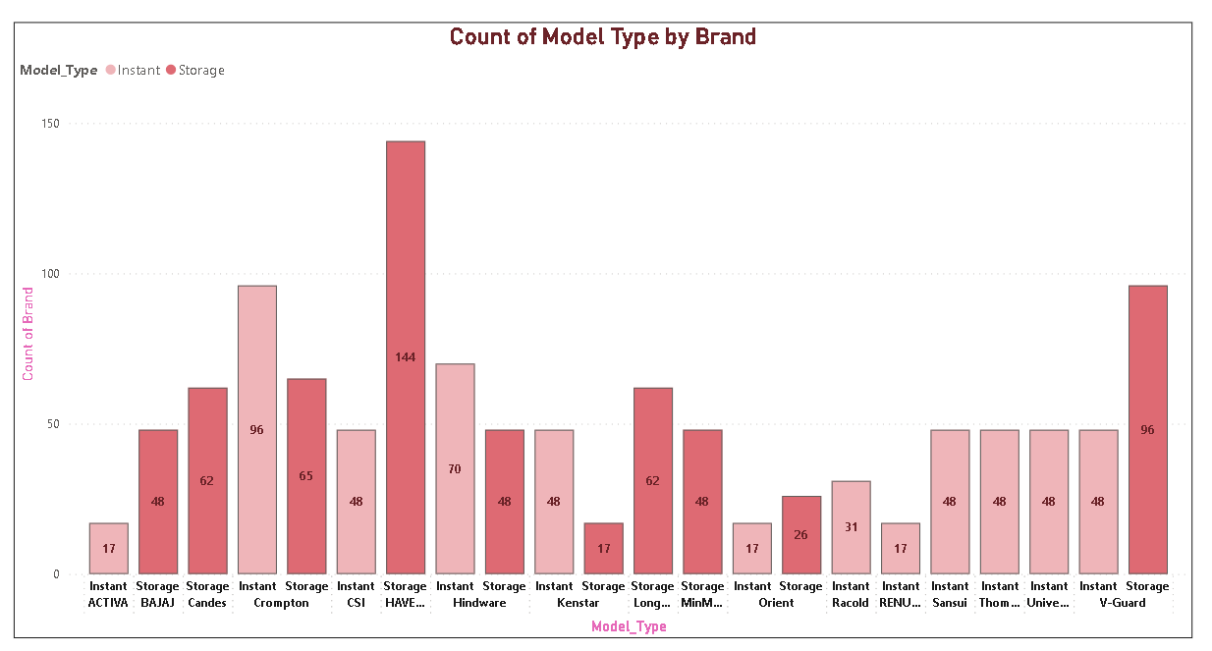
Model types available in each brand

Slide 16
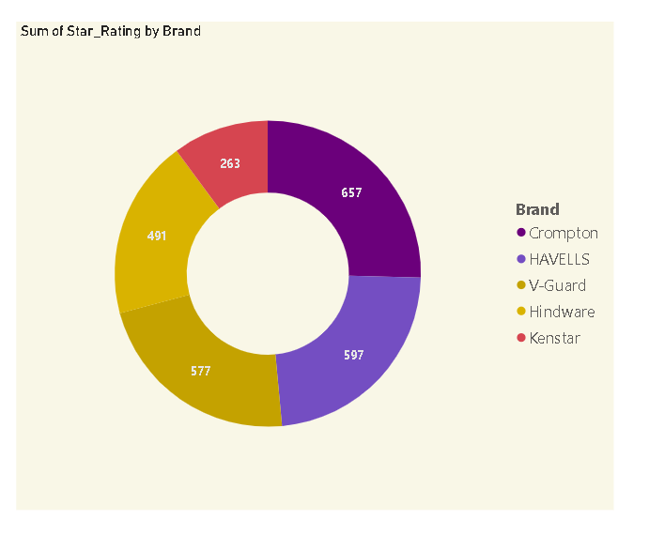
Top 5 Brands
Crompton has highest ratings

Slide 17
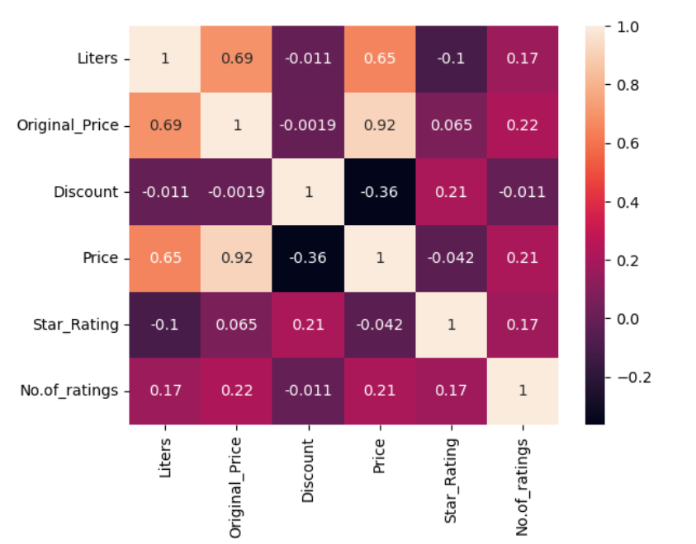
Heat Map

Slide 18
Challenges faced :
Extracting data related to Rating.
Formatting extracting data using RegeX method.
Plotting charts, which one to use for a particular data analysis point.

Slide 19
I BUY?
Which GEYSER should

Slide 20
Conclusion :
Crompton stands out as the most reliable brand in our dataset.
When it comes to model preferences, the top choice is undeniably the storage type.
For the ideal capacity, a 3-liter model is the unanimous favorite among consumers.
Geyser which receives more positive-rating, becomes a good choice for users.

Slide 21


Slide 22

Thank You

